Slide 1

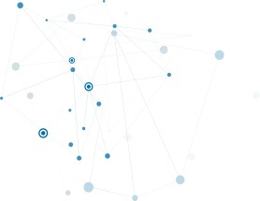

Unlocking the Power of Digital Transformation & IT Solutions
https://www.idctechnologies.com/idcdigital/
© 2025 IDC Technologies. All rights reserved - Confidential

Slide 2
Welcome to IDC Digital
Empowering Digital Evolution: As the leading digital and technology division of IDC Technologies, we empower organizations to flourish in the digital era with the latest innovations and solutions.
IDC Manpower Services
IDC Technologies
IDC Digital Services
IDC Digital’s comprehensive suite of end-to-end digital and smart services addresses all traditional and transformational needs. We are a one-stop IT Service Provider for accelerating your business objectives using best-in-class consulting & technology solutions.

Slide 3
Company Highlights
Global Presence
Industry Certified
Industry Leadership
North America, Europe, Australia, Singapore, Malaysia, UAE, & India
NMSDC Certified MBE, BBB Certified Business, E-Verify Certified, ISO 9001:2015, ISO 27001:2013, ISO 20000-1:2011 Certified. Also, CMMI Level 3 Certified.
Seasoned experts & leaders trailblazing digital solutions for all sectors
Founded
Headquarter
No. of Years
Served
Guiding Innovation with Growth & Proven Expertise
IDC Technologies was Founded in 2003
Headquartered in Milpitas, CA
21 Years
5500+ Employees Globally

Slide 4

IDC Technologies
Netherlands
We co-create your Digital Future
London
Canada
Poland
Boston
Germany
Staffing, Digital and Application services being delivered seamlessly with global workforce of 5500+ professionals
Denver
San Francisco
New York
Noida
Austin
Gurugram
Mexico
Bengaluru
Malaysia
Costa Rica
Dubai
Washington
Abu Dhabi
Singapore
Agile Transformation
Pune
DevOps/SRE
Chennai
Software Engineering
Application Development
Big Data, AI, ML, RPA
Sydney
Cloud Architecture
Wellington
Automation/ AIOps
Infrastructure Services
Our Global Footprint
Application Maintenance
Cyber Security
21 Years Successive Growth

Slide 5

Our Value Proposition
Centers Of Excellence
ERP, Web & Mobile, Salesforce, SRE/DevOps, Testing, RPA
Practical Implementation Experience
30% ~ 45% proven efficiency improvements
120+ Engagements
Access To Global
Talent Pool
Polyglot Technologies
Ready to deploy, 2500+ IT Professionals
Committed Technical Leadership
Our Value
Proposition
Proven Experience
Delivery centers in the Middle East, USA, India
100+ professionals deployed to work on various global projects from offshores in India
Industry Best Practices
& Approach
Industry Best Practices to drive development & maintenance
Field tested approach (e.g., IDC Global Delivery Methods)
Assets & Accelerators for rapid development

Slide 6

















Our Industry Verticals
Global Industry Solutions: Unleashing Expertise for Every Sector Worldwide
Consulting
Software Development
Information Technology
Customer Service/Multilingual
Banking, Financial Services and Insurance
Telecom
FMCG
Energy Trading
Oil and Gas
Retail
Pharma
Automotive
Utilities
Renewables
Transportation/Logistics/Marine
© 2024 IDC Technologies. All rights reserved - Confidential

Slide 7







































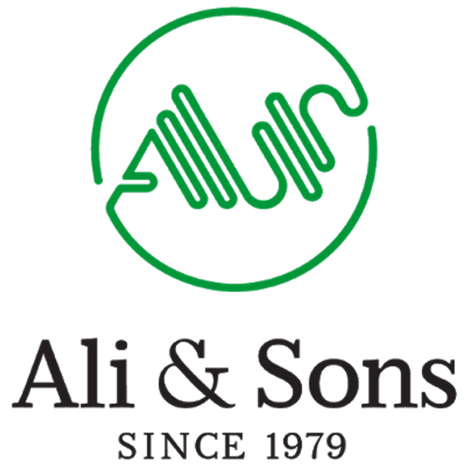








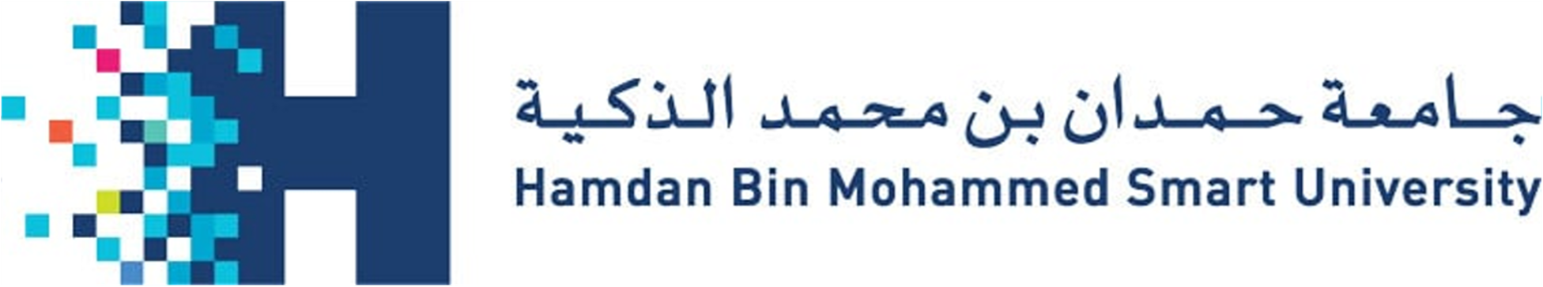



Our Distinguished Clients | Middle East
Aviation
Government
Healthcare
Automobile
Automotive, Real Estate,
Travel, hospitality
Education
BSFI
FMCG
Travel & Hospitality

Slide 8




































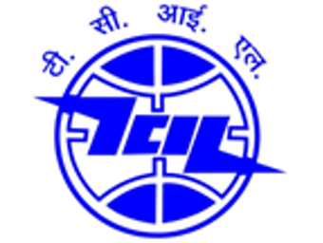





















Our Distinguished Global Clients
BSFI
Automobile
Telecom, Media &
Entertainment
Retail, Consumer
Good & Distribution
Pharma, Health &
Life Science
BSFI
Automobile
Travel & Hospitality
Ecommerce
Government
© 2025 IDC Technologies. All rights reserved - Confidential
Notes:
This is the new slide

Slide 9







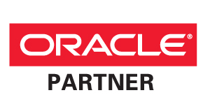

Our Partnerships
Notes:
Add Snowflake and Redington

Slide 10
IDC Digital
IDC Digital | Our Offering Stack
Services Capabilities
IDC Digital
Digital Disruption
Application Modernization
Platform Enablement
Smart Services
Cyber Security
Operations Support
Digital Transformation
Omni Channel Microservices
DevSecOps
Data Platform Transformation
Vulnerability Assessment and Pen Testing
Managed Support
Strategy And Consulting
Cloud First
Site Reliability Engineering
Artificial Intelligence and Machine Learning
Managed Detection and Response
L1/L2 Outsourcing
Enterprise Modernization
Quality Engineering
Observability
Blockchain
IAM and GRC
Operations Management
Multi Speed
Mobile First
Public and Private Cloud Services Automation
Business Process Automation and RPA
Consulting and Advisory
Operations Reliability
Empowered by IDC Staffing Services
IDC Technologies

Slide 11
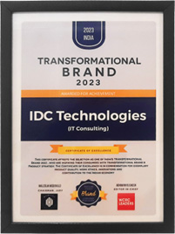
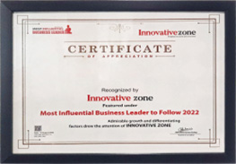
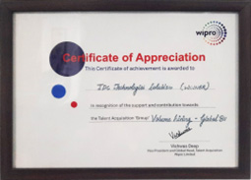

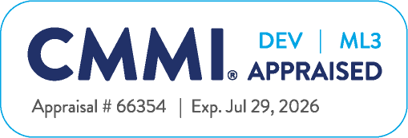

Awards & Accolades | IDC Technologies
2023
2022
2022
2023
2024
Top 100 tech companies founded and managed by Indians in the U.S.
Best Resourcing Partner Wipro – Year 2014, & Year 2015
52 Fastest-growing Private Companies In The Silicon Valley – Oct 2013
Top Companies In California On The Inc. 5000 Fastest-growing Private Companies – Sept 2013
Top IT Services Companies On The Inc. 5000 Fastest-growing Private Companies – Sept 2013
5000 Fastest-growing Private Companies In America – Sept 2013
5000 Fastest-growing Companies In America – Sept 2012
Top South Asian-run Companies On The Inc. 5000 – Sept 2011
Top Companies In The San Jose Metro Area On The Inc. 5000 Sept 2011
Top Companies In California On The Inc. 5000 – Sept 2011
Top It Services Companies On The Inc. 5000 – Sept 2011
Top companies in the San Jose metro area on the Inc. 5000 – Sept 2010
5000 Fastest-growing Private Companies In America – Sept 2010
© 2024 IDC Technologies. All rights reserved - Confidential
Notes:
This is the new slide

Slide 12
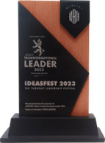
Awards & Accolades | IDC Technologies
2023
2022
2022
2023
2023
Top 100 tech companies founded and managed by Indians in the U.S.
Best Resourcing Partner Wipro – Year 2014, & Year 2015
52 Fastest-growing Private Companies In The Silicon Valley – Oct 2013
Top Companies In California On The Inc. 5000 Fastest-growing Private Companies – Sept 2013
Top IT Services Companies On The Inc. 5000 Fastest-growing Private Companies – Sept 2013
5000 Fastest-growing Private Companies In America – Sept 2013
5000 Fastest-growing Companies In America – Sept 2012
Top South Asian-run Companies On The Inc. 5000 – Sept 2011
Top Companies In The San Jose Metro Area On The Inc. 5000 Sept 2011
Top Companies In California On The Inc. 5000 – Sept 2011
Top It Services Companies On The Inc. 5000 – Sept 2011
Top companies in the San Jose metro area on the Inc. 5000 – Sept 2010
5000 Fastest-growing Private Companies In America – Sept 2010
© 2024 IDC Technologies. All rights reserved - Confidential

Slide 13
PORTFOLIO
Key Case Studies

Slide 14
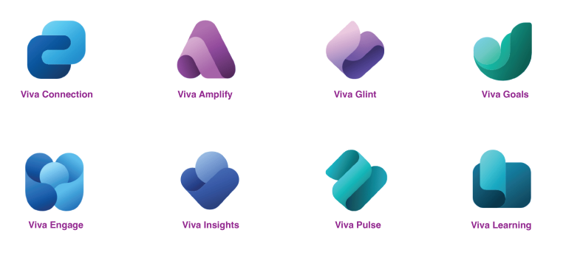

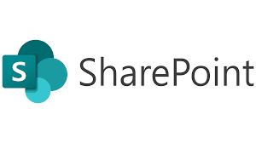

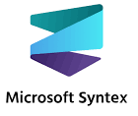
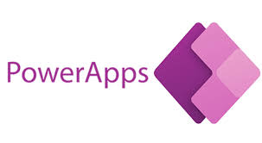

Case Study: Health Care Group – Integrated DMS
A private healthcare group with 4,500+ employees across 7 hospitals and 25 clinics needed a unified platform for managing clinical documentation and HR communications.
Facing fragmented document storage, difficulty managing guidelines and policy updates, and manual compliance tracking.
Challenge
Scattered documents
Manual compliance checks
No central HR or communication hub
65% faster policy updates
Better employee engagement
99.8% document compliance
50% drop in HR queries
Solution
Modern intranet and document system
Automated policy workflows
Integrated employee portal and learning systems
Technologies

Slide 15
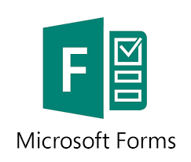
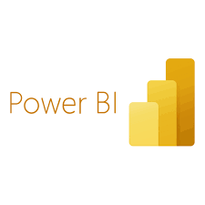
Case Study: Global Logistics & Supply Chain – Integrated DMS
A global logistics company with 8,000+ employees across 20 countries faced inefficiencies due to decentralized document storage and siloed tools.
Poor coordination and the absence of a unified communication platform hindered cross-functional collaboration.
Challenge
Local file storage and duplicates
Poor internal communication
Compliance risks
30% faster customs processing
No duplicate documents
90% employee engagement
Better customer satisfaction
Solution
Centralized SharePoint-based DMS
Automated workflows for document alerts and reviews
Modern intranet with multilingual support
Technologies

Slide 16


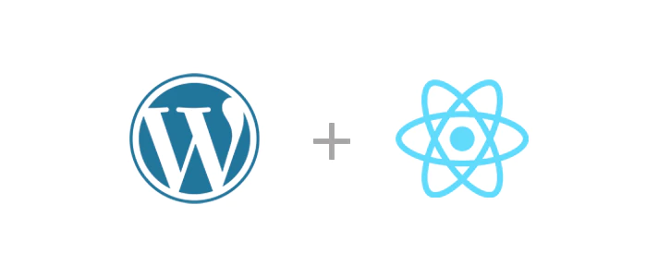
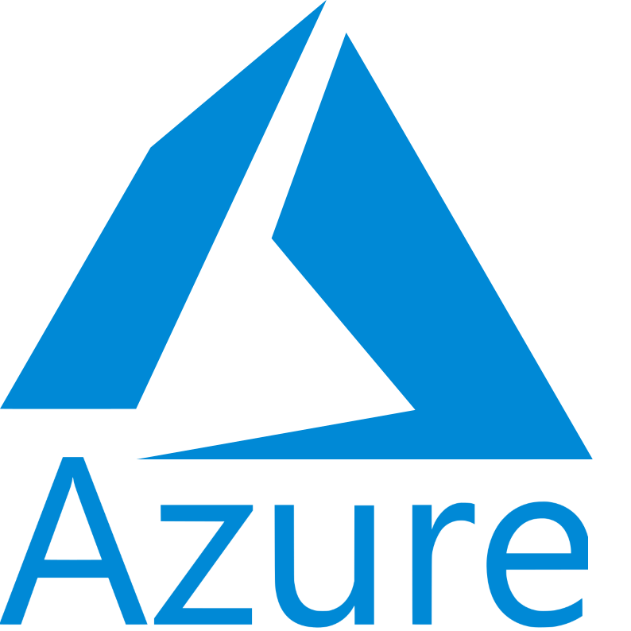
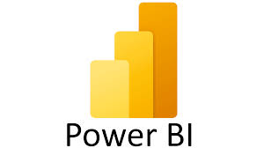
IDC and Al Nabooda Affinity Program for Enterprises
Opportunity
SOLUTION
BUSINESS OUTCOMES
Automate Affinity Program: Implement an automated system for the Affinity program to generate opportunities and deliver tailored offers to enterprise customers.
Data-Driven Strategy: Develop a data-driven Affinity program to enhance revenue and increase new car sales.
Revenue and Sales Boost: Utilize the Affinity program to drive higher revenue and stimulate new car sales.
Impact Analysis: Use data to analyze and understand the Affinity program's impact on new car sales.
Digital Transformation: Create a digitally transformed experience through a user-friendly, approval-based web application using WordPress CMS to support the Affinity program.
User Management: Implement admin features for efficient user management, including roles and permissions.
Offer Management: Enable the creation, publication, and modification of offers through the admin interface.
Real-Time Insights: Provide real-time insights and analytics reports to monitor the program’s performance and impact.
Customization and Personalization: Develop capabilities to tailor offers and communication to the specific needs and preferences of customers.
Increased Revenue: Achieve a 20% increase in revenue from new car sales through targeted offers and promotions within the Affinity program.
Higher Customer Engagement: Attain a 30% improvement in enterprise customer engagement rates as measured by participation in the Affinity program and interactions with personalized offers.
Improved Conversion Rates: Boost conversion rates by 25% for leads generated through the Affinity program, translating into a higher number of new car sales.
Enhanced Customer Retention: Achieve a 15% increase in customer retention rates among enterprise customers participating in the Affinity program, as tracked by repeat purchases and continued program participation.
TECHNOLOGIES USED
Major Global Brand
($40B+ Revenue)
Automated Affinity Program, Real-time reporting
Rapid, scalable and elastic infrastructure
Agile Delivery Methodology
8 Sprints in 2 months

Slide 17



Case Study | Markolines
Opportunity
SOLUTION
BUSINESS OUTCOMES
The business challenge expressed was to make the organization digitally transformed by implementing the SAP™ Business ByDesign®
Our qualified resources engaged in planning, designing, developing, and implementing various work packages associated with the modules outlined below:
Finance, Accounts, & Taxation
Human Resource Management
Business Development and Sales
Procurement
Store Management
Project Management
Reporting & Analytics
Streamlining financial processes, ensuring accuracy and compliance.
Implementing a centralized accounting system for real-time financial insights.
Designing a comprehensive HR module for employee lifecycle management. Automation of payroll, benefits administration, and talent acquisition processes.
Integrating sales processes to improve forecasting, order fulfillment, and customer satisfaction.
Developing a centralized procurement system for efficient vendor management. Automating purchase requisition, order processing, and inventory management.
Developing customizable dashboards for real-time business intelligence. Incorporating advanced analytics tools for trend analysis and forecasting.
Reduced manual intervention in finance, HR, procurement, and other processes, resulting in time and cost savings.
Improved data quality enhances decision-making and reduces the risk of errors in financial reporting and other critical areas.
Efficient lead management and CRM contribute to increased sales effectiveness.
Cost analysis tools help in optimizing procurement decisions
TECHNOLOGIES USED

Slide 18



Case Study | Etihad
Opportunity
SOLUTION
BUSINESS OUTCOMES
A leading enterprise in the aviation sector faced challenges in optimizing their SAP landscape, aligning it with their evolving business needs, and ensuring the seamless operation of critical business processes.
Recognizing the need for specialized SAP resources, they sought a trusted IT service provider to enhance their SAP capabilities and support ongoing digital transformation initiatives.
As a premier IT service provider specializing in SAP solutions, we identified the unique requirements of our client and proposed a comprehensive resource augmentation strategy. Leveraging our extensive pool of SAP experts, we meticulously matched their needs with a tailored team of highly skilled professionals across various SAP domains, including SAP HANA, BASIS administration, ABAP development, Fiori, Business Warehouse, Finance, HCM, and more.
Our approach focused on quality, expertise, and strategic resource allocation. We employed a rigorous recruitment process, emphasizing SAP certifications, industry experience, and deep expertise in SAP HANA, ensuring our resources were well-equipped to address the client's specific challenges.
Achieved a 95% satisfaction rate in resource quality and expertise, as measured by client feedback surveys.
Implemented KPIs to measure candidate performance, focusing on project delivery timelines, issue resolution time, and adherence to best practices.
Demonstrated deep expertise in SAP HANA, resulting in a 30% improvement in data processing speed and real-time analytics capabilities.
Reduced system downtime by 15% through proactive monitoring and issue resolution, enhancing overall system reliability.
Achieved a 25% improvement in system performance metrics, leading to faster response times for critical business transactions.
TECHNOLOGIES USED

Slide 19

Case Study | MSIG
Opportunity
SOLUTION
BUSINESS OUTCOMES
SAP support projects are one of the most important aspects of any organization’s IT infrastructure. Without a well-organized and managed SAP support project, organizations would be unable to effectively utilize their SAP systems and gain the maximum benefit from them.
The Client needed to deal with SAP-related issues across Singapore. Below were the detailed activities:​
System Health Checks​
Data Patches​
Deployments ​
Debug Access​
Partner API Deployment​
SAP Incidents. ​
IDC Technologies helped the client by having a separate skilled SAP Support team spread across the region to attend all the calls on time to meet the SLA defined by the client.​
The solution for the SAP Support project involved establishing a robust and responsive support framework to address any system-related issues, ensuring continuous system availability and optimal performance.​
Regular system health checks, user training, and documentation updates were conducted to enhance overall system reliability and efficiency.​
We provided comprehensive support for SAP modules, and minimized system downtime, ensuring uninterrupted business processes. ​
Improved productivity and streamlined workflows across various departments. ​
Enhanced the system's performance, optimizing response times and overall user experience. ​
We mitigated risks, reducing the likelihood of critical errors and potential disruptions through proactive issue resolution and regular system health checks​
TECHNOLOGIES USED

Slide 20
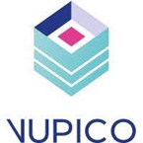
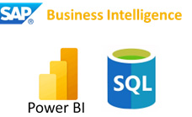
Case Study | Vupico
Opportunity
SOLUTION
BUSINESS OUTCOMES
The existing manual process of generating reports using Excel spreadsheets from various SAP Reports and external data sources is identified as inefficient.
Improved Data Visualization: The primary objective is to enhance data visualization through Power BI.
Alignment with Data-Driven Decision-Making: The project reflects a commitment to promoting data-driven decision-making within TRM.
Operational Efficiency and Effectiveness: The successful implementation of these improvements is expected to contribute to increased operational efficiency and effectiveness.
The proposed solution involves a comprehensive overhaul of the current manual report generation process within the TRM KPI Dashboard Project.
We aimed to streamline data retrieval and processing, addressing the existing inefficiencies associated with Excel-based reporting.
Developed eight additional reports, each tailored to specific aspects of maintenance and operations that are meticulously designed to enhance user-friendliness and provide meaningful visualizations for maintenance users and operations managers.
The implementation of the second phase of the TRM KPI Dashboard Project by IDC Technologies represents a significant step towards optimizing data-driven decision-making within Vupico's TRM.
Streamlined data retrieval and processing through the development of eight additional reports.
The project enhanced the user-friendly visualization of the reports for maintenance users and operations managers. This strategic initiative aligns with best practices in data visualization and reporting, fostering increased operational efficiency and effectiveness.
TECHNOLOGIES USED

Slide 21



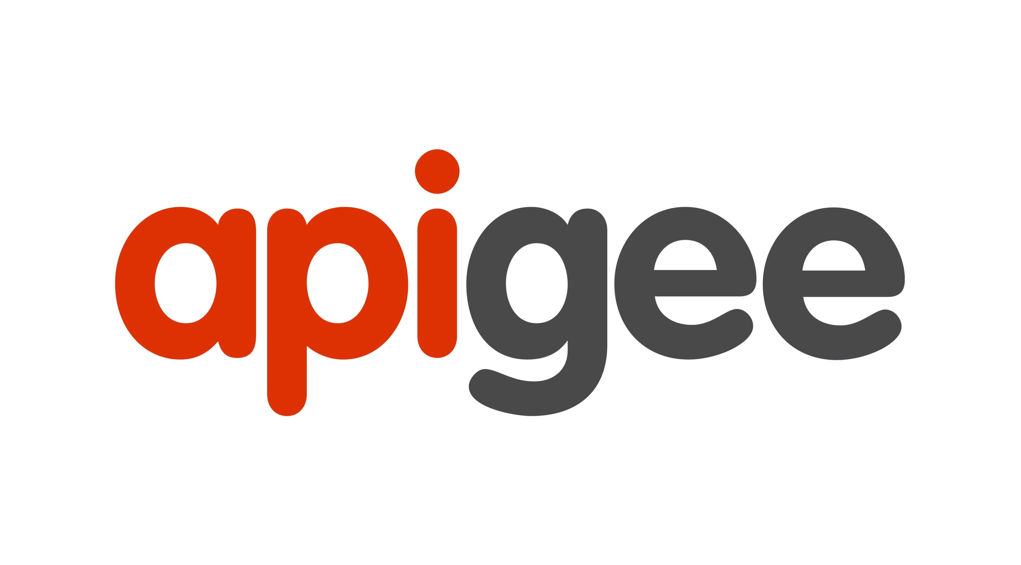
Case Study | App Modernization: Hamriya Free Zone Authority Sharjah Government
TECHNOLOGIES USED
Opportunity
SOLUTION
BUSINESS OUTCOMES
BUSINESS NEEDS
The client was looking for building a platform based smart mobile app that will hosts common business services such as port application approvals, senior management notifications etc. enabling Omni-channel capabilities by consolidating the existing MRP and Channel specific Middleware
The client was looking to accelerate ITs innovation strategy by converting their monolith middleware into containerized microservices. Client was completely on-premises, looking for a way to move toward their cloud-first strategy
OUR SOLUTION
IDC helped the client by strangulating existing monolithic application into unique microservices that allowed smart approval workflows.
MEASURABLE OUTCOMES
Usage of API Gateway for governed service access from all channels (internal/external) brought unified standardization.
Realtime curated data was consumed from EDP and Data science models via REST API's.
Fault tolerant and scalable, customized platform leads to higher reliability and faster delivery.
IMPROVED OMNICHANNEL EXPERIENCE
Increased Customer Interactions for Senior management and above
Insulates changes to backend systems and enabled reliable delivery
Reduced time to market
10% reduction in cost for release of new features.
Canary and feature flagging leads to testing in production.
BUSINESS PROCESS
TRANSFORMATION
Booking, Inventory Search, Loyalty, Offer to Order, Order Fulfillment
UAE Based
($500 M Revenue)
Trading, Manufacturing Process Automation
Ecommerce Omni-channel API strategy
Real-time Data Consumption
3 Sprints of 2 weeks each

Slide 22
Thank You!
Happy to start a conversation around your specific needs!
Reach us at :
Sender's Name : Saurabh Kakra
Email Id : saurabh.kakra@idctechnologies.com
www.idctechnologies.com/idcdigital
© 2024 IDC Technologies. All rights reserved - Confidential

